Slide 1
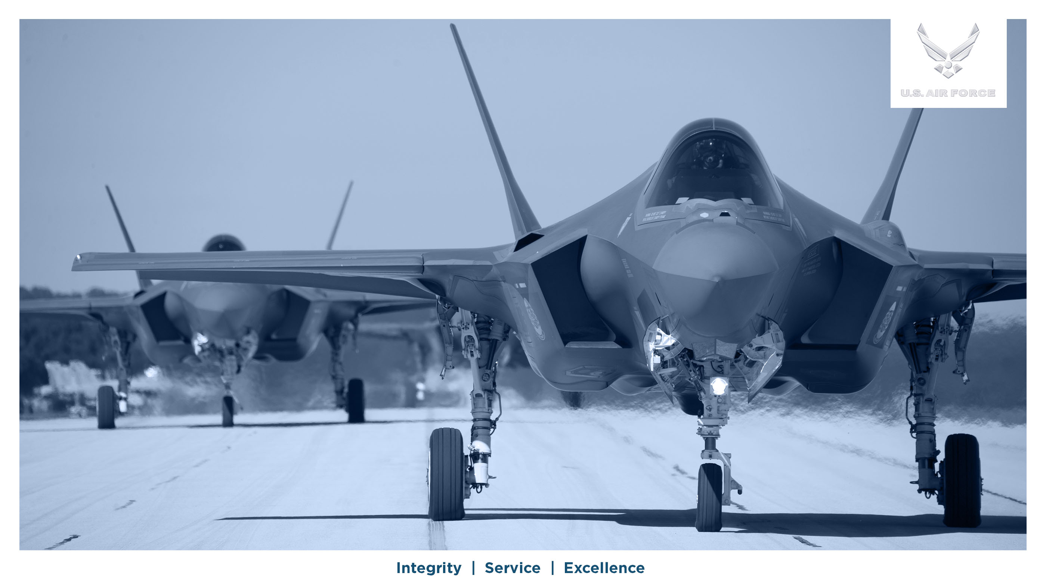

Welcome to the Eglin Passenger Terminal 72-Hour Forecast

Slide 2


DEPARTURES FROM:
EGLIN AFB, FL (VPS) AND DUKE FIELD (EGI)
DEPARTURE BASE | ROLL CALL | DESTINATION | SEATS
Eglin AFB |  | No Scheduled Flights
Seat Releases: T=Tentative; F=Firm
All flights are subject to change without notice

